Slide 1
OLAP Queries
OLAP: Online Analytic Processing
OLAP queries are complex queries that
●
●
Touch large amounts of data
Discover patterns and trends in the data
Typically expensive queries that take long time
Also called decision-support queries
Select salary From Emp
Where ID = 100;
●
In Contrast :
OLTP: Online
OLTP queries
OLTP queries
Transaction Processing
are simple queries, e.g., over banking or airline systems touch small amount of data for fast transactions

Slide 2
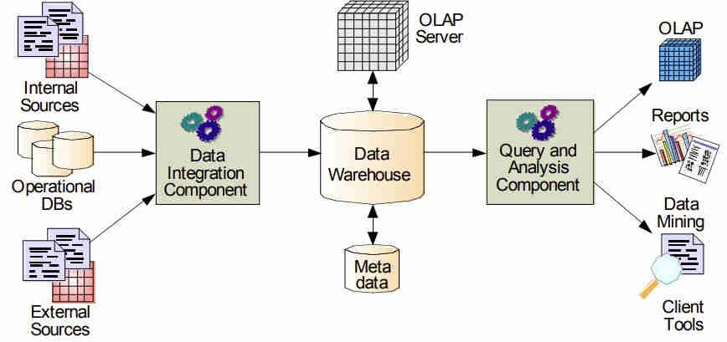
OLAP AND DATA WAREHOUSE

Slide 3
OLAP
Queries
●
Typically, OLAP queries are executed over a separate copy of the
working data → Over data warehouse
●
Data warehouse is periodically updated, e.g., overnight → OLAP queries tolerate such out-of-date gaps
●
Why run OLAP queries over data warehouse?
✗
Warehouse collects and combines data from multiple sources
✗
Warehouse may organize the OLAP queries
OLAP queries are complex and
- They may lock the database
data in certain formats to
touch large amounts of data for long periods of time
support
✗
- Negatively affects all other OLTP transactions

Slide 4
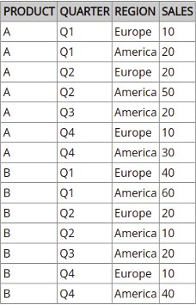
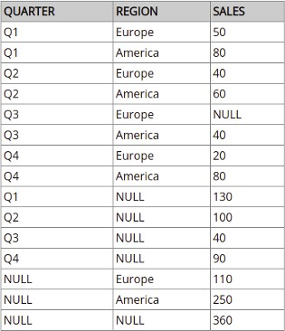
OLAP queries in SQL
Consider the following sales table
SELECT QUARTER, REGION, SUM(SALES) FROM SALESTABLE
GROUP BY CUBE (QUARTER, REGION)

Slide 5
Online
Query
Computation:
Query
●
A query has the general form : <a1,a2,…...,a_{n}: M>
●
Each a_{i} has 3 possible values
Instantiated value
Aggregate (*) function
Inquire (?) function

Slide 6
Multidimensional OLAP queries
●
OLAP queries and tools in data warehouse analysis processing.
The basic OLAP query language is MDX.
assist in reports and
●
●
Multidimensional Expressions is a query language for getting
access to multidimensional data structures.
●
MDX queries work with OLAP members, dimensions and hierarchies. With MDX it is possible to query data from SQL server and get a dataset with axis and cell data.

Slide 7
Multidimensional
OLAP
queries
●
SELECT: the principle MDX statement. SELECT points out the
dimension members that will be parts of axis;
●
WHERE: identifies the dimension or member that are used as slicer dimensions;
●
WITH: calculates the sets named during SELECT and WHERE clauses processing;
●
FROM: determines the source of multidimensional data to which our
query is addressed to.
SELECT
{[Measures].[Unit Sales], [Measures].[Store Sales] } ON COLUMNS,
{[TIME].[1997], [TIME].[1998]} ON ROWS
FROM Sales
WHERE ( [Store].[USA].[CA] )

Slide 8
Data Warehouse back end tools
Data warehouse systems use back-end tools and utilities to populate and refresh their data. These tools and utilities include the following functions
●
Data extraction, which typically gathers data from multiple, heterogeneous, and external sources
●
Data cleaning, which detects errors in the data and rectifies them when possible
●
Data transformation, which converts data from legacy or host format to warehouse format
●
Load, which sorts, summarizes, consolidates, computes views, checks integrity, and builds indices and partitions
●
Refresh, which propagates the updates from the data sources to the warehouse

Slide 9
Testing in Data warehouse
●
The process of creating and running detailed test cases to ensure
that data in a warehouse is trustworthy, accurate, and compatible
with the organization's data structure is known as
data warehouse
testing.
Because of the rising emphasis on data analytics and the way
●
complicated business insights are recognized on the assumption that data is reliable, Testing is critical for modern firms.

Slide 10
Data warehouse testing process
●
Identify the various entry points : If testing is done only
at the as it
destination, becomes more
Prepare the
it can be confusing when errors are found
difficult to determine the root cause.
●
required collaterals : Two fundamental collaterals
required for the testing process are database schema representation and a mapping document.
●
Design an elastic, automated, and integrated testing framework :
●
Adopt a comprehensive testing approach : Application components
such as ETL tools, reporting engines, or GUI applications need to be included in the testing framework. Also, it’s important to design multiple testing approaches such as unit, integration, functional, and performance testing.

Slide 11
Testing in Data warehouse
Data Warehouse stores huge amount of data, which is
typically collected from multiple heterogeneous source like files, DBMS, etc
to produce statistical result that help in decision making.
Testing is very important for data warehouse systems for data validation and to make them work correctly and efficiently.
There are three basic levels of testing performed on data warehouse which are as follows:
Unit Testing Integration Testing System Testing
●
●
●

Slide 12
Testing in Data warehouse → Unit Testing
●
This
type
of testing is being performed at the end.
developer’s
●
In unit testing, each unit/component of modules is separately tested.
●
Each modules of the whole data warehouse, i.e. program,
SQL Script, procedure,, Unix shell is validated and tested.

Slide 13
Testing in Data warehouse → Integration Testing
●
In this type of testing the various individual units/
modules of the application are brought together or combined and then tested against the number of inputs.
●
It is performed to detect the fault modules and to test whether the various performing well after integration.
in integrated components are

Slide 14
Testing in Data warehouse → System Testing
●
System testing is the form of testing that validates
and tests the whole data warehouse application.
●
This type of testing is being performed by technical testing team.
●
This test is conducted after developer’s team performs unit testing and the main purpose of this testing is to
check whether the entire system is working altogether or not.

